Slide 1
Source | Percent Total Drag
Fuselage | 8.8%
Sponson | 1.0%
Sponson Strut | 0.2%
Horizontal Tail | 4.7%
Vertical Tail | 3.0%
Wing | 82.3%
any
Speed &
Air Density

Slide 2
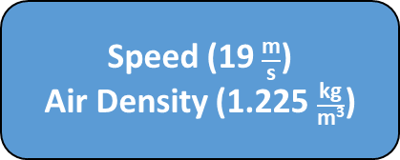
Source | Wetted Area (m²) | Total C_{d} | Total Drag (N) | Percent Total Drag
Fuselage | 03.40 | .010 | 7.50 | 8.8%
Sponson | 00.19 | .020 | 0.84 | 1%
Sponson Strut | 00.16 | .005 | 0.18 | 0.2%
Horizontal Tail | 02.26 | .008 | 4.00 | 4.7%
Vertical Tail | 01.45 | .008 | 2.70 | 3%
Wing | 16.68 | .019 | 70.00 | 82.3%
Speed (19 $\frac{\text{m}}{\text{s}}$)
Air Density (1.225 $\frac{\text{kg}}{\text{m}\text{3}}$)

Slide 3
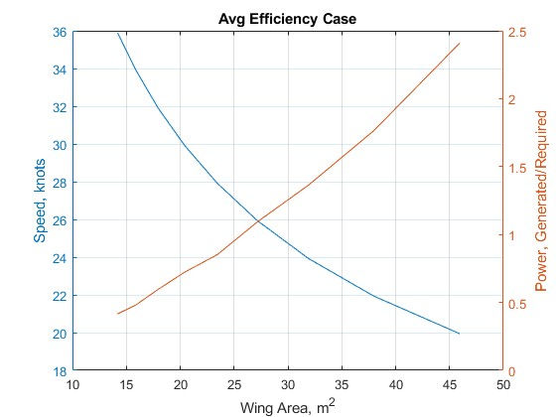

Slide 4
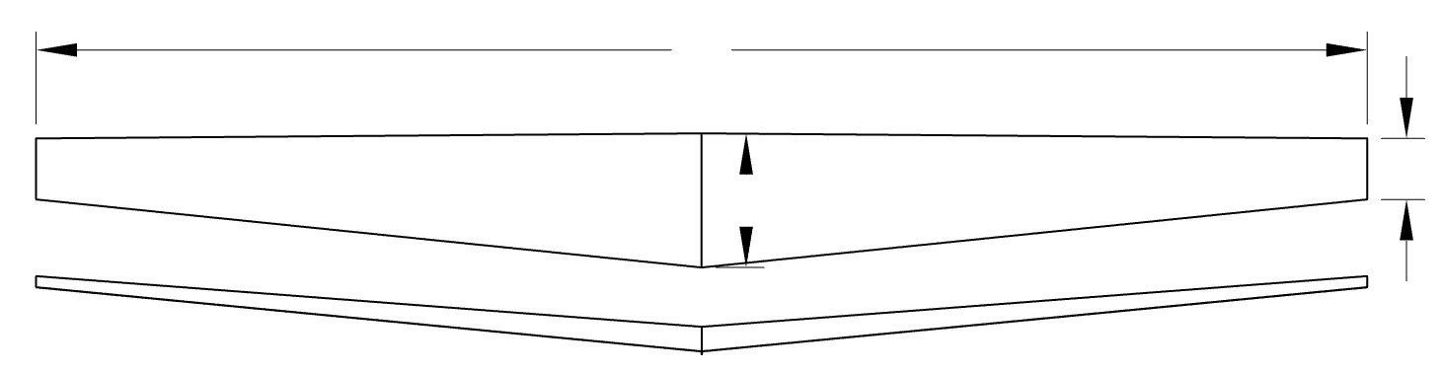
586” span
59” root
27” tip
14.8 m
0.67 m
1.49 m
5°

Slide 5
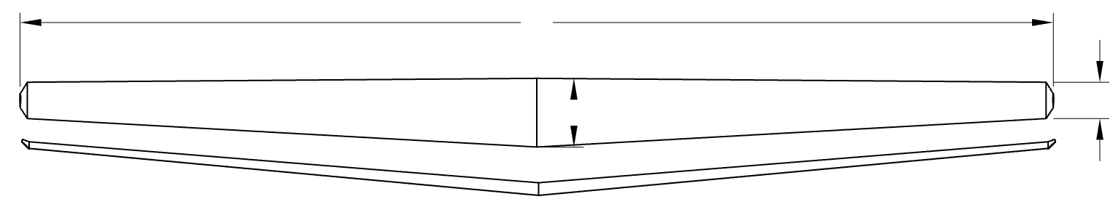
22.4 m
1.5 m
0.8 m
5°

Slide 6
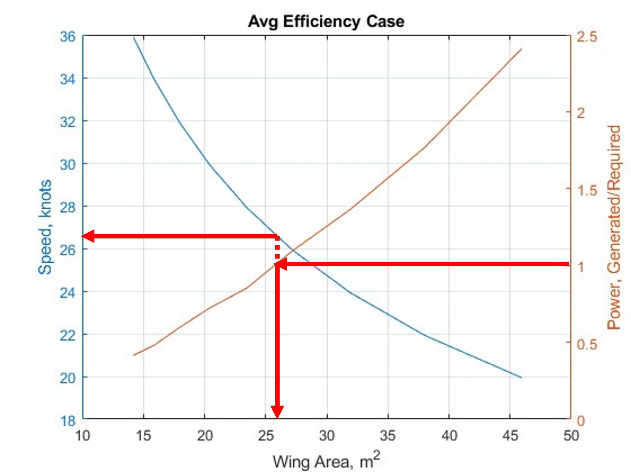
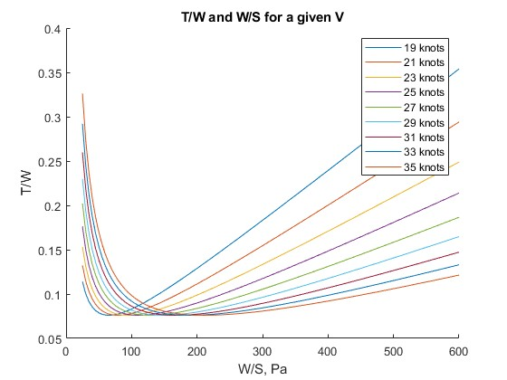

Slide 7
